Slide 1
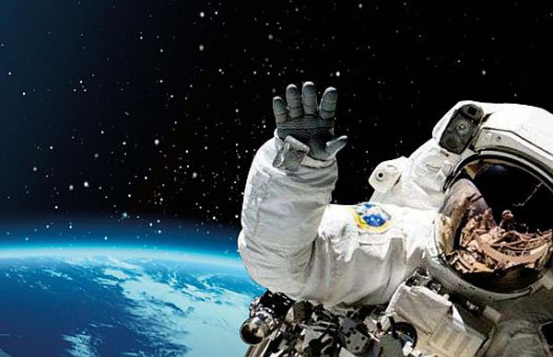
Physical and Psychological Challenges of Space Travel
Presented By Laurice Hinn
http://www.starshipsodyssey.com/wp-content/uploads/2015/10/space-exploration.jpg

Slide 2
THE QUESTION:
What are some of the long term effects of space travel on the human body?
Comes from the article, “Physical and Psychological Challenges of Space Travel: An Overview, by M.G. Ziegler and J.V. Mack
Notes:
Much of what many of us know about space travel, unless it’s an area of interest, is learned from what we see on TV or in movies – for example, StarTrek, Interstellar, The Martian, Star Wars or Prometheus. I personally believe that these kinds of beliefs and ideas are key – they form the basis to which we ask questions. Do aliens exist? Can we live on Mars?

Slide 3
QUESTION FOR YOU:
What are some of the myth’s you have heard of regarding space travel?

Slide 4
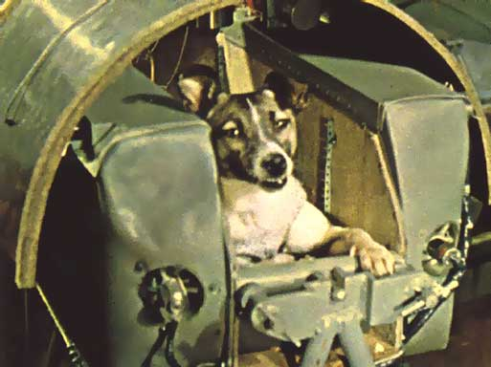
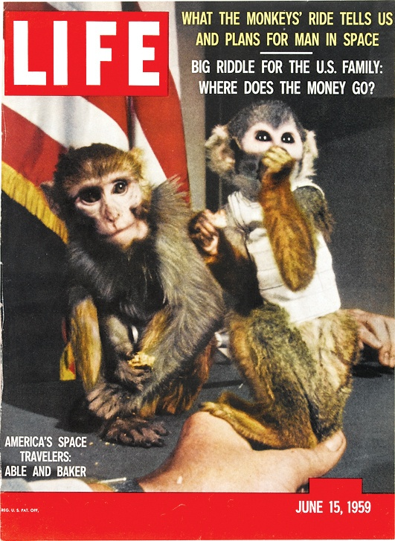
Human Adaptation to Space
Major problem associated with space travel is human adaptation to space.
Late 50’s – Animal testing in space
Laika – Russian dog sent to space
Able and Baker – American Squirrel monkeys
https://s-media-cache-ak0.pinimg.com/736x/31/f3/34/31f334c030353887ff2a22b4950ffc35.jpg
http://i.kinja-img.com/gawker-media/image/upload/s--I63_EA9g--/vpjnmwhjtgjrtzankemu.jpg
Notes:
Many of the problems associated with space travel involve human adaptation to space travel. The Goal is to learn about what we as humans are capable of, and what the limits to human adaptation are in space. Animal studies taught us a lot about whether or not humans could survive in space. The Russians were able to launch a dog, Laika, into space, but could not retrieve her. To one up the Russians, the Americans launched Able and Baker, American Squirrel monkeys, which they were able to retrieve. The whole point was to see if they could travel and function (do the assigned task) and not be overcome by the shock of space travel.

Slide 5
Human Adaptation to Space
1960’s – The U.S. and Soviet Russia attempt to reach the moon.
1969 – Mission Apollo (U.S.) reaches the moon
Minimal research on Astronauts, research relied on travels to Antarctica, in submarines and research submersibles, and simulators
NASA mandates the requirements for human research during space travel
Notes:
The Dawn of the Space age was considered to be 1957, and by 1969, the world had it’s first man on the moon. A lot of the research done was on travels to Antarctica, in submarines and research submersibles, and simulators. Psychology itself has come a long way, especially because we’ve been able to shrink the size of technology (miniaturization) and develop the technology to take psychological assessments and evidence based countermeasures. NASA has provided documents through the Human Research Program, which include that research must be operationally relevant (as to save costs, and to ensure safe, reliable and productive human space exploration).

Slide 6
Weightlessness
Weightlessness – having no weight, no force to support your body
Head-down bed rest at a 6 degree tilt can reproduce the fluid shifts occurring in weightlessness
Styf et. al. – Modified head-down bed rest produced intense lower back and abdominal pain, headaches, leg pain, and feelings of depression.
https://www.youtube.com/watch?v=-GIhsj8Fk6U
Notes:
Weightlessness plays a huge role in some of the physiological changes that take place in the body during space travel. In order to understand why the body reacts the way it does during space travel, you have to understand what weightlessness is. Chris Hadfield, a Canadian astronaut, has done a series of youtube videos while up in space, and a lot of them give us a glimpse into the life of an astronaut in space.
This sensation can be reproduced by the head-down bed rest. Lying in a bed at a 6 degree tilt can reproduce some of the fluid shifts that occur in space.
A study by Styf et. al. mentioned in the text revealed that a modified version of head-down bed rest produced increased feelings of depression, as well as intense lower back, abdominal pain, headaches and leg pain.

Slide 7
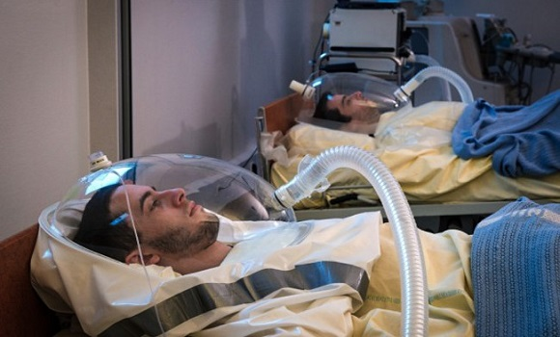
NASA Study on weightlessness
NASA was recently seeking applicants to stay in bed for three months in exchange for 18,000 dollars
http://1.bp.blogspot.com/-B0QYSX809fs/Vl2n5QgowRI/AAAAAAAAFIk/xYrirrY64OQ/s1600/x6.jpg
Notes:
More recently, as many of you might have heard, NASA has been conducting studies where they will pay you to stay in this position for 18,000 dollars for 70 days, not able to move or get out of bed, so that they can learn more about the effects of weightlessness on the human body.

Slide 8
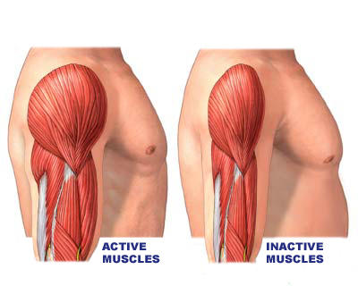
Human Skeletal Muscle
https://www.youtube.com/watch?v=SKwLEsulVaw
Spinal nerves stretch, account for growth in space, as well as back pain.
Back pain one of the most frequently occurring medical problems in space (68% of astronauts)
Lose bone density (2% for each month)
Muscle loss in space (20% in the first 2 weeks
https://edc2.healthtap.com/ht-staging/user_answer/avatars/315325/large/open-uri20120721-26304-z1wwfu.jpeg?1386593793
Notes:
Changes in height are experienced in space, up to 3%. This means someone who is 6’0 can return to earth at about 6’2. The spine is able to relax in space, which causes people to grow as the spinal nerves stretch, but can also lead to back pain because of the stretch. This effect does not last, as astronauts shrink back to their normal size on earth.
Because there is not a lot of effort required to move around, muscle atrophy, as their muscles begin to deteriorate quicker.
There is also a massive loss in bone density, which can increase the chances of kidney stones and fractures.
Muscle loss occurs, because there is less gravitational load on the bones and muscles. We don’t need to use much effort to get around in space.
NASA has implemented ultrasound technology to track changes in the spine every 30 days, which allows astronauts to evaluate the movement of muscles, blood in vessels, etc.

Slide 9
Return to Earth
Prolonged weightlessness produces problems with abnormal baroflexes, uncoordinated gait, impaired motor control.
Muscle soreness, tight hamstrings and calves
Study by Cooke et al. recorded electrocardiogram, finger photoplethysmographic pressure, and respiratory flow before, during, and after two 9 month long missions.
Exercise – before, during, after.
Notes:
Baroflexes help control the body’s blood pressure changes. Study by Cooke et. all measured four modes of breathing. This study showed that these baroflex changes can persist for weeks, occurring very early in space travel and can persist. There is a specific exercise regimen that astronauts must comply to before, during, and after space time in order to combat these effects. Resistance training occurs before and during space travel, and muscle conditioning and rehabilitation occurs after.

Slide 10
Changes in human physiology during the First 3 Days In Space
Cardiovascular and hormone physiology one of the first things to alter due to weightlessness
Changes in sympathetic nerve activity
ACTH and ADH hormones increase
Reduced fluid and food intake
“Puffy face-bird leg” syndrome”
Reduced plasma volume
Notes:
Cardiovascular and hormone physiology are one of the first things to change during space travel due to the effects of weightlessness. Changes take place in the sympathetic nerve activity, which controls your fight or flight reflexes. As your body escapes from the effects of gravity, the ACTH and ADH hormones increase. The ACTH hormones help to regulate cortisol, which contributes to a person’s metabolic rate and ability to manage stress. ADH hormones regulate the body’s retention of water, and kick in when you are dehydrated in order to conserve water. This is believed to be a response to the stress and nausea astronauts may feel during their departure from Earth’s gravity. There is reduced fluid and food intake at this point, as astronauts adapt to space sickness. There is reduced plasma volume, and reduced volume in the lower limbs due to fluid redistribution. Because all the fluids are being pushed towards the head, facial fullness and puffiness of the head, along with reduced volume in the lower limbs, makes people look like they have puffy faces and birds legs. Reduced plasma volume is due to reduced fluid intake and reduced urination, the fast fluid shifts due to the reduced compression from gravitational forces, as well as needing less muscle tone to maintain posture.

Slide 11
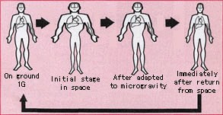
Return to Earth
Study by Meck et al.
20% of astronauts cannot tolerate upright posture for 10 minutes on return to earth
Problems with hypotension and sympathetic nervous system withdrawal become more severe with long-duration weightlessness.
Orthostatic intolerance
Difficult to re-adjust after longer periods of time
http://www.asc-csa.gc.ca/images/sciences/mso/osm-veineuse-deplace-fluides-eng.jpg
Notes:
A study by Meck et.al found that approx 20% of astronauts could not tolerate upright posture for 10 minutes on return to earth. They performed tilt tests (where patients lie down and eventually the table turns upright into a standing position) on six astronauts before and after long duration spaceflights and compared them to results obtained from previous short duration missions. Differences were found in stroke volumes (amount of blood pumped in the heart) and cardiac outputs (volume of blood per minute), suggesting a possible decrease in cardiac contractile function.
Orthostatic intolerance are a collection of symptoms that appear when placed in an upright position, which can be relieved by reclining. This includes fatigue, lightheadedness, anxiety, exercise intolerance, weakness, altered vision and losing consciousness to name a few.
Upon re entry, astronauts can wear a pressurized anti-gravity suit to minimize the amount of fluid that pools in the legs, as well as a lying down position on the way down.

Slide 12
QUESTION FOR YOU:
Can you think of what some of the major stressors may be in space?

Slide 13
Stress in Space
Effects of weightlessness, isolation, difficult routine cited as stressors.
Kansas et al. references major stresses of space travel including sleep disorders, anxiety, autonomic disturbances (ie. palpitations), concentration and attention difficulty, sensitivity to bright lights and noises
NASA assesses motivation to participate, tolerance for stress, decision making skills, emotional maturity, ability to work with others, physical exams, alongside astronaut proficiencies.
Notes:
It’s important to remember that astronauts are human too, and succumb to the same emotional and psychological stresses as everyone else.
The study was based off of the writings of George Beard and Russian psychologists. They called the group of major stresses in space “asthenia”, which develops in cosmonauts after 1-2 months in space. Symptoms include sleep disoriders, anxiety, autonomic disturbances (ie. palpitations), concentration and attention difficulty, sensitivity to light and bright noises. NASA currently uses psychological tests, psychological and psychiatric interviews, and incorporates tests that are quantitively scored in order to select the best candidates.

Slide 14
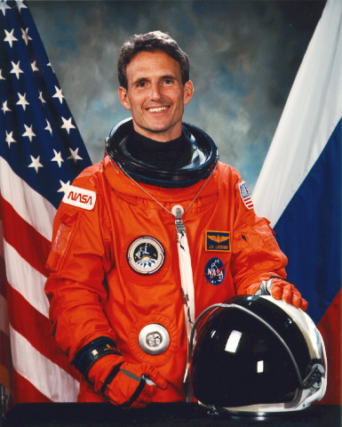
Sleep Disturbances
Case study on astronaut J.Linenger’s 5 months in space by Monk et al.
Studied effects of prolonged time in space on the endogenous circadian pacemaker
Internal clock severely impacted after 3 months, resulting in problems affecting sleep, alertness, and immune function
https://upload.wikimedia.org/wikipedia/commons/thumb/6/6e/Jerry_Linenger.jpg/220px-Jerry_Linenger.jpg
Notes:
The article mentions the space flight of J.Linenger, and describes it as one of the most dangerous and stressful on record. Linenger’s days lasted less than 2 hours, and so you can see how this would severely impact one’s internal clock. By taking oral temperatures, keeping sleep diaries, taking performance tests, they concluded that the body is able to function well up to 90 days in space. Anything longer than this affected sleep, alertness, and immune function.

Slide 15
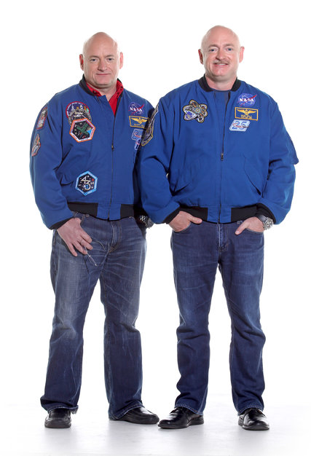
Immune Function
Oral antibiotics absorbed differently due to weightlessness
Confinement of the space station ideal for the spread of diseases
Mills et al – study shows changes in immune cells on return from weightlessness
Twin Study – 2015-2016 – Mark and Scott Kelly to study affects of space flight.
http://static01.nyt.com/images/2014/03/25/science/25TWIN/25TWIN-blog427.jpg
Notes:
Circadian rhythms and the sympathetic nervous system, as previously mentioned, have a great impact on the body, both on earth and in space. If the sun rises or sets every 90 minutes, the body can’t take natural clues as to what time of day it is. Because of these changes, immune functions may also change.
Weightlessness also affects gastrointestinal function, which means that oral antibiotics are absorbed poorly by the body. 10 days prior to launch, astronauts are only allowed minimal contact with outside persons prior to launch.
The study mentioned in the article by Mills et al., which showed changes in immune cells, demonstrated by an increase in white blood cells, on return from weightlessness. They suggest that this is caused by the stress of spaceflight and landing, causing the mediated redistribution of white blood cells. This effect may be weakened after longer missions where the body is able to get over the effects of weightlessness.
Twin study is currently being conducted by NASA to evaluate the effects of space travel on the body. Identical twins share the same DNA, and so NASA will be able to compare the effects of space by comparing the twins to each other!

Slide 16
Immune Function AND IT’S IMPLICATIONS
Stowe et al.
Stresses associated with spaceflight resulted in decreased virus-specific T-cell immunity and reactivation of EBV.
Immune suppression
Virulence changes in bacteria
Notes:
The article mentions a study by Stowe et al, which studied the effects of stress and space travel on levels of neuroendocrine hormones and the EBV (Epstein Barr Virus) specific antibodies in astronauts. They collected samples of urinary stress hormones and plasma samples before launch, on landing day, and 3 days after landing. They found that the specific T cell immunity diminishes and that EPV actually reactivates during space travel.
Immune suppression is the altered ability of the immune system to respond to stimulation. The results from this study, and others, indicate the changes that can occur in the immune system when exposed to microgravity. Virulence changes in bacteria is also harmful, as some bacteria can become more harmful or disease causing after growing in space! This is obviously a bad combination, as the enclosed quarters of the spaceship, and the long period of time spent in them, can harbour these kinds of diseases.

Slide 17
In Conclusion…
Weightlessness plays a huge role in the effects of space on the body
Space travel presents physical and psychological challenges, both during travel and upon return
More research still needs to be done to determine how humans can adapt to space travel
Notes:
Many of the side affects of space travel occur because of weightlessness. The body must adapt to the loss of gravity, which can confuse the body. Initial feelings of nausea, stress, and sinuses clogging are often followed by back pain, headaches, feelings of depression due to changes in hormones, the sympathetic nervous system, fluid losses, muscle and bone loss and in the immune system. What I find most fascinating is the body’s ability to adapt to these kinds of changes within a matter of days. The longest time a person has ever spent in space is 437 days, and research on these kinds of trips give us knowledge on what factors would need to be considered for longer durations of space travel, for example, to Mars. Eyesight and bone loss are two areas that are the most concerning when it comes to space travel. I think that it’s quite obvious that the longer you stay in space, the worse some of these side affects can be.

Slide 18
Resources
"Astronaut Bio: J. M. Linenger 8/01." Astronaut Bio: J. M. Linenger 8/01. Web. 8 Jan. 2016. <http://www.jsc.nasa.gov/Bios/htmlbios/linenger.html>
“Flies in Space – Immune System: Changes in Space.” National Aeronautics and Space Administration. Web. 5 Jan. 2016. http://quest.nasa.gov/projects/flies/compareImmune.html
Kramer, Miriam. “New Study Examines Why Astronauts Grow Taller in Space | Space.com.” Space.co. PURCH. Web.8.Jan.2016. http://www.space.com/19116-astronauts-taller-space-spines.html
“Plasma and Blood Volume in Space.” National Center for Biotechnology Information. U.S. National Library of Medicine. Web. 7 Jan. 2016. <http://www.ncbi.nlm.nih.gov/pubmed/17630598>
“Psychology of Space Exploration.” NASA History Series. National Aeronautics and Space Administration, 2011. Web. 8. Jan. 2016. <http://www.nasa.gov/pdf/607107main_PsychologySpaceExploration-ebook.pdf>
Space Top 5: Effects of Space on the Human Body. Youtube, 2013. Web. https://www.youtube.com/watch?v=K92hPetmYWM
Williams, David, Andre Kuipers, Chiaki Mukai, and Robert Thirsk. "Acclimation during Space Flight: Effects on Human Physiology." CMAJ : Canadian Medical Association Journal. Canadian Medical Association. Web. 9 Jan. 2016.

Slide 19
Youtube Links
Weightlessness: https://www.youtube.com/watch?v=-GIhsj8Fk6U
Exercise in Space: https://www.youtube.com/watch?v=SKwLEsulVaw
Twin Study: http://www.cbc.ca/player/play/2661851387

