Slide 1
Urban Behavior
Helpfulness in the Urban environment

Slide 2
Urbanism
Negative relationship between helpfulness and urban cities
complex of traits which reflects the urbanite’s adaptation to a situation in which social relationships are often transitory, role-defined and superficial.”
Urban city dwellers have little to no personal or social relationships with each other

Slide 3
Urban density & Altruism
‘altruism decreases as a function of density”. (Rushton, 1978)
People from locations differing in urban pop density were asked for help on 4 measures
For the time
For directions
For change for a quarter
For their names
Data was gathered from;
Downtown Toronto
The suburbs
A small town in the same area

Slide 4
Urban density & altruism
No differences in gender in either offering help or receiving it, except on 2 occasions
F > M, receiving help (40% vs. 20%)
M > F, offering help (40% vs. 20%)
Helping decreased as urban density increased
3 hypothesis for the negative relationship;
People living in cities socialize differently than people in small cities in consideration for others
The less urbanely dense the area a person is raised in, the more likely they are to engage in helping behavior
People living in big cities encounter many stressors which leads to their decreased altruism

Slide 5
Stimulus overload

Slide 6
Input overload
Urban ‘bombardment’ & input overload (Korte & Milgram)
Inability to process incoming input from the environment because the system is already dealing with too much information (Milgram, 1970)
These inputs include events and people in the environment (noise, traffic, pedestrian density, etc.)
Humans have to adapt to this overload
“Overloads lead to adaptive mechanisms that create the distinctive tone and behaviors of city life.”

Slide 7
Adaptations to overload
Devoting less time to each input
Filtering inputs; Ignoring non-essentials
Blocking or tuning out some incoming inputs
Urbanites act according to their adaptations to overload

Slide 8
Input overload
Input overload = lack of environmental awareness
High input levels = low levels of helpfulness
Korte et al (1975); street interviews (73% vs. 63%); directions (6% vs. 1%); lost key (47% vs. 33%)
Korte & Grant (1976); traffic noise

Slide 9
Urban Layout
Architectural design of urban cities has an effect on helping behavior
Newman (1973); “architectural features of an urban residential environment influences the degree to which residents can perceive and control activity that occurs within their residential space.”
Helping behavior is lower when space is less defensible
People in high apartment buildings are associated with low helping behaviors (Huismans & Korte, 1977)

Slide 10
59% vs. 84%

Slide 11
Social behaviors
Influence of by-standers; the less the better
Convenience of avoiding people needing help
Racial differences; responding to input from similar ethnic backgrounds
Fear of crossing boundaries; respect for people’s privacy

Slide 12
Bystander Effect
https://www.youtube.com/watch?v=OSsPfbup0ac

Slide 13
Assaulting my girlfriend – social experiment
https://www.youtube.com/watch?v=nEDl8XR_duQ

Slide 14
Helping strangers
Difficulties in helping strangers; physical & emotional vulnerability of urban residents
Dangers of living in a city; increased vulnerability (Altman et al)
Town residents are more friendly than urban residents

Slide 15
Kindness of strangers
Investigated the difference in pro-social behaviors btw 24 US cities in help offered to strangers
6 predictors of differences in helping strangers
Population size
Population density
Population stability
Economic well-being
Pace of life
Crime

Slide 16
Kindness of strangers
3 measures of helping
Dropped pen
Hurt leg
Change for a quarter
1 measure of pace of life
- walking speed
2 measures of economic well-being
Purchasing power (avg family income)
Poverty rates (% of pop whose income was below poverty line)

Slide 17
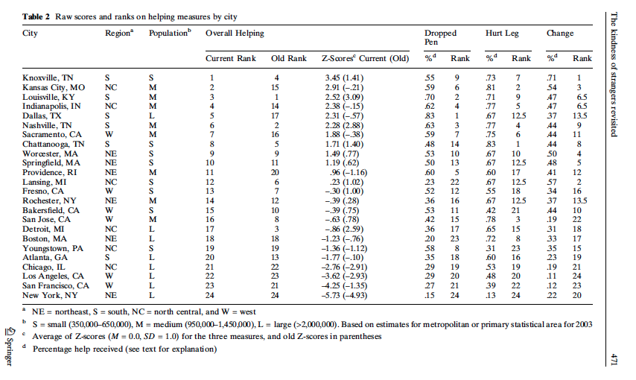

Slide 18
Kindness of strangers
No gender differences except on 2 occasions
No significant regional differences on individual measures of helping
Negative correlation btw walking speed & helping behavior
Strongest predictors of helping behavior were pop size, density, economic well-being & walking speed
Large cities had higher poverty & crime rates

Slide 19
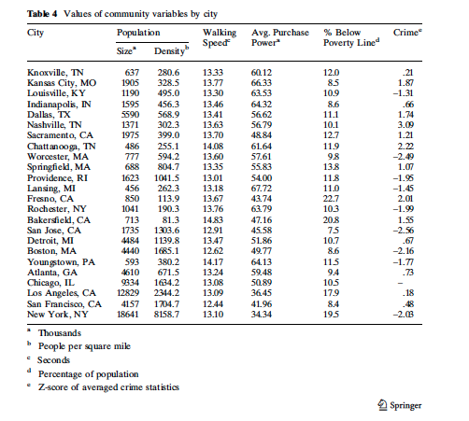

Slide 20
Experimental evidence
Milgram (1970); ‘wrong number’ experiment
Korte & Kerr (1975); ‘lost letters’ experiment
Darley & Latane (1968); “laboratory accident’ experiment
Gelfand (1973); shoplifting
Helpfulness was higher in small towns compared to urban cities

Slide 21
Little lost girl video
https://www.youtube.com/watch?v=R5aIpUVAwZs

Slide 22
Limitations
How is urbanization defined?
Differences exist within a single urban area and between difference urban areas
Cultural and inter-urban differences in urban cities
Failure to identify other specific factors influencing unhelpfulness in urban cities
Environmental influences?

Slide 23
Environmental determinism vs. environmental selection
ED; The belief that the environment influences behavioral patterns
ES; Rather than just adapting to their environment, urbanites select the type of environment that best fits their needs/preferences
Environment-behavior associations could be attributable to both environmental determinism & selection

Slide 24
Environmental determinism vs. environmental selection

Slide 25
Questions?

