Slide 1
Noise

Slide 2
What is noise?
Any type of sound
Usually refer to loud or unpleasant sounds as “noise”

Slide 3
How is noise measured?
Sound waves create pressure
The amount of pressure relates to loudness
Noise is measured in dB
dB are measured on a logarithmic scale
Notes:
Environmental noise is measured in decibels (dB). To better approximate the range of sensitivity of the human ear to sounds of different frequencies, the A-weighted decibel scale (dBA) was devised. Because the human ear is less sensitive to low frequency sounds, the A-scale de- emphasizes these frequencies by incorporating frequency weighting of the sound signal. When the A-scale is used, the decibel levels are represented by dBA. On this scale, the range of human hearing extends from about 3 dBA to about 140 dBA. A 10-dBA increase is judged by most people as a doubling of the sound level.

Slide 4
How noise applies to psychology
Affect and health
Environmental noise can impact our health via stress, mood
Behaviour
Exposure to environmental noise can influence behaviour such as helping, aggression
We cope with unwanted noise by changing our behaviour
Cognition
Noise perception can change depending on exposure length (adaptation)
Noise can change how we learn or complete tasks
Notes:
I’ve broadly grouped Affect and health together.
Current mood influences how annoyed we get by certain noises and how sensitive we are to noise (Vastfjall, 2002)

Slide 5
Sources of noise
Outdoors
Airplanes, traffic, wind, animals, construction
Indoors
Ventilation systems, neighbours, electronics, conversations
Notes:
Note that noise gets a lot less media attention than other forms of pollution because it is less obvious
There are very few regulators that enforce noise compliance (mostly only on construction sites).

Slide 6
Video
Things to consider:
What are examples of the sources of environmental noise given in the video?
How do people change their behaviour to cope with noise?
What affect did noise have on some of the people interviewed?
Notes:
Note that noise gets a lot less media attention than other forms of pollution because it is less obvious
There are very few regulators that enforce noise compliance (mostly only on construction sites).

Slide 7
Noise and health
Wind farm opponents cheer federal study of health effects
The Canadian Press Posted: Jul 11, 2012 9:37 AM ET Last Updated: Jul 11, 2012 2:57 PM ET

Slide 8
Hans Selye 1907-1982
Selye was the pioneer in stress theory.
Stress was defined as the nonspecific response of the body to any demands made upon it.
Notes:
Austrian-Canadian!

Slide 9
Noise and health
What demands does noise put on the body?
According to Selye’s General Adaptation Syndrome (GAS), noise can cause stress which leads to arousal in the body
GAS model: Alarm (prepare to meet a threat), resistance (coping), exhaustion (physical resources are depleted)

Slide 10
Noise and health
Think about how the GAS model applies to hearing a car alarm go off

Slide 11
Noise and health
Increase in hypertension (high blood pressure)
Increased consumption of medication
Increased hospital admissions
Increase in physician visits
Increase in cardiovascular problems
Increase in sleep problems
Increase in mortality
Lower birth weight babies
Slower height and weight gains in children
Hearing loss
Notes:
Note that these are likely symptoms of chronic uncontrollable, unpredictable environmental noises

Slide 12
Noise and health
But can we psychologically adapt to the stress caused by noise? It appears so:
Nivison, M.E. and Endresen, I.M. (1993) An analysis of the relationships among environmental noise, annoyance and sensitivity to noise and the consequences for health and sleep, J Behav Med, 16, 257-276.
http://www.hc-sc.gc.ca/ewh-semt/noise-bruit/turbine-eoliennes/summary-resume-eng.php
Lazarus and Folkman (1984) model considers the psychological appraisal of stressors (harm, threat, challenge)
Perception of stress, coping, vulnerability
Notes:
Describe the findings from Nivison and Endersen
Government study found no grounds for complaints made
Summarize: “People show signs of both long-term strain and habituation to chronically stressful events. Most people can adapt moderately well to mildly stressful events’ however, it may be difficult or impossible for them to adapt to highly stressful events, and already stressed people may be unable to adapt or even moderate stressors.”
Currently available scientific evidence does NOT support a causal relationship between turbine noise and health.
Stress model: coping can be internal and external locus of control. Looking at behaviour, we see some external locus of control coping techniques

Slide 13
Noise and behaviour
What behaviours do we engage in to cope with environmental noise?
Drown it out

Slide 14
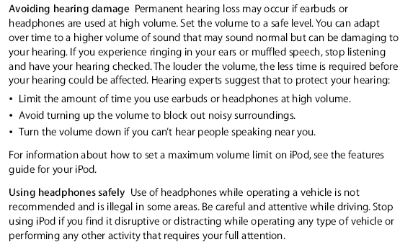
Apple’s iPod Warning

Slide 15
Noise and behaviour
What behaviours do we engage in to cope with environmental noise?
Compensate

Slide 16
Noise and behaviour
What behaviours do we engage in to cope with environmental noise?
Design around it
Notes:
Note that these examples are “active or direct” coping styles. People can also engage in other coping styles such as avoidance, seeking social support, optimism, seeking control over the situation, cognitive reframing to change the meaning of the situation without changing the actual environment (Lercher, 1996).
If you’re interested in coping behaviours in general, check out the Lazarus and Folkman work.

Slide 17
Noise and behaviour
How does noise change how we behave?
We help less in environments with a high level of environmental noise (Page, 1977)
The number of people who helped pick up dropped cards decreased in environments with more noise
Noise Level | % Helping
50 dB | 60
80 dB | 45
100 dB | 35

Slide 18
Noise and behaviour
How does noise change how we behave?
We help less in environments with a high level of environmental noise (Page, 1977)
The type of help we provide may be related to sex
Level of street noise | Total % help offered
72 dB (normal) | 90
92 dB (construction) | 80
Physical help offered |  | Verbal help offered
Male | Female | Male | Female
72 | 39 | 14 | 45

Slide 19
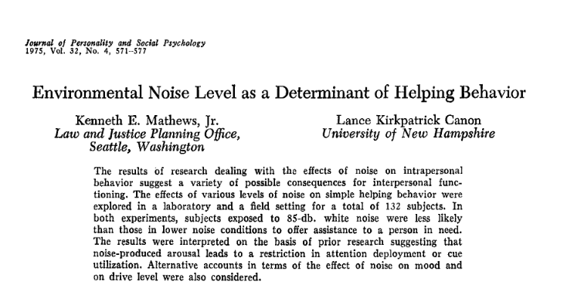
Noise and behaviour
Similar results were found by Mathews and Canon (1975)

Slide 20
Noise and behaviour
Possible Explanations for Less Aid Under Noisy Conditions
Information overload may cause screening of inputs and a de-emphasis on needs of others
Noise may function as a distractor
Noise may prevent verbal communication, raising costs (efforts) of social interaction
Production of negative affect and mood change: irritation, annoyance, unpleasantness
Aversive quality of noise may lead to escape, reducing likelihood of assistance

Slide 21
Noise and cognition
Environmental noise can impact how we learn, perceive, and process information
This is especially true for children because
They have better hearing than adults, but poorer listening skills
They have immature attention mechanisms
They require a higher signal: noise ratio
They have weak frustration coping skills

Slide 22
Noise and cognition
Adults may cope with noise by tuning their attention. That is, they attempt to focus only on relevant sensory input
Children raised in noisy environments may not have the ability to tune out distractor noises or to identify appropriate vs. inappropriate sound cues
This may lead to poor verbal and reading skills

Slide 23
Noise and cognition
How does noise change how we learn?
Children who learn in a noisy classroom perform worse on reading tasks relative to children in quieter classrooms (Bronzaft, 1981)
Bronzaft measured reading achievement test scores at a school located 220 feet from an elevated train line—classes were disrupted every 4.5 minutes for a 30 second interval.

Slide 24
Noise and cognition
Students on the noisy side did significantly poorer on the standardized reading test.

Slide 25
Noise and cognition
After noise reduction (rubber rail mounts, acoustic ceilings), total noise decreased 6-8dBA (train noise level = 81-83 dBA)
There were no significant reading test differences for quiet and noisy classrooms following the noise reduction interventions.
Is a Hawthorne effect possible?
Notes:
Several years later, they installed rubber rail mounts to help reduce noise level of the train.
Hawthorne effect = perform better when being observed.

Slide 26
Noise and cognition
Children exposed to chronic noise also experience:
less persistent when it comes to completing tasks
Poorer auditory discrimination
Reduced physical growth
Slower psychological development
Poorer progress on standardized tests
Lower tolerance for frustration
Heightened blood pressure
Lessened perceptions of control
Lowered attentiveness
Heightened distractibility
Notes:
LAST OF THE LECTURE SLIDES

Slide 27
Make Up Exam
Exam 1 & 2 make up:
Friday, November 27
1 – 4 pm
BSB 061
Only individuals who have provided proper documentation will be able to write the make up
4 essay questions worth 25 points each

Slide 28
Final Exam
IN CLASS! DECEMBER 2

